Slide 1
The 4 P’s in PM Spectrum (1)
Lecture 3

Slide 2
The 4 P’s in PM Spectrum
People
Product
Process
Project

Slide 3

People [1]
Stakeholders
Team Leaders
Software Team

Slide 4
People
The most important factor in success of software project.
“Companies That sensibly manage their investment in people will prosper in the long run”.
Cultivation of motivated and highly skilled software people
has always been important for software organizations.
The “people-factor” is so important that Software Engineering Institute has developed People Management Capability Maturity Model (PM-CMM).

Slide 5
PM-CMM
Organizations that achieve high levels of maturity in PM-CMM have a higher likelihood of implementing effective software engineering practices.

Slide 6
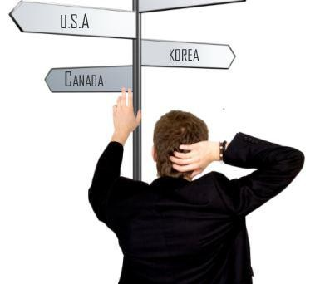
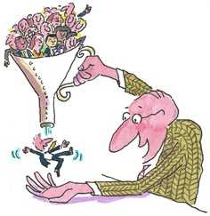

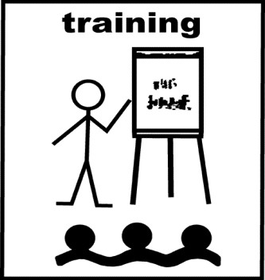
PM-CMM
Key Practice Areas of PM-CMM
  Recruiting [3]
Selection [3]
Performance Management [4]
Training

Slide 7
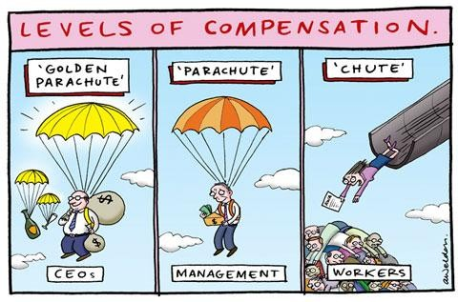

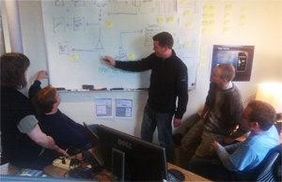
PM-CMM
Key Practice Areas of PM-CMM
  Compensation [5]
Organizational design [6]
Career development [7]
Team/culture development [8]

Slide 8
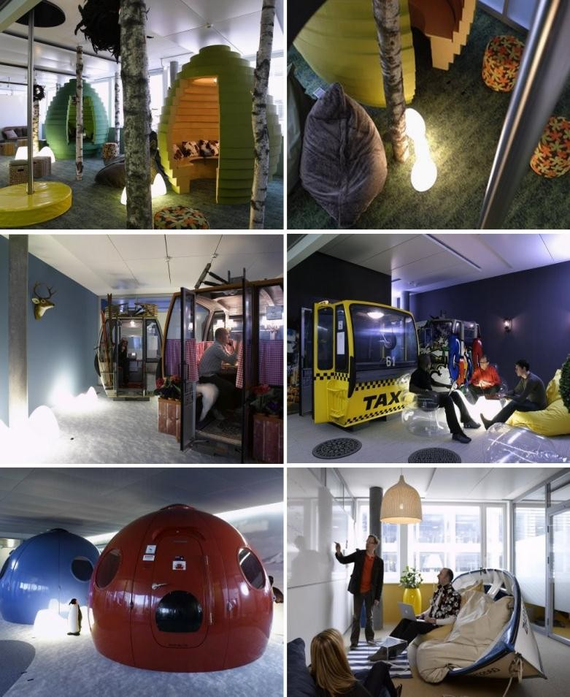
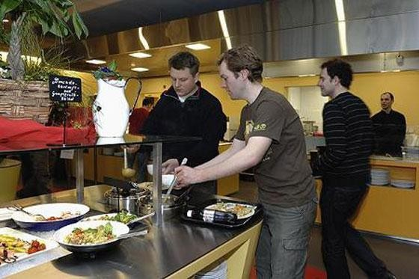
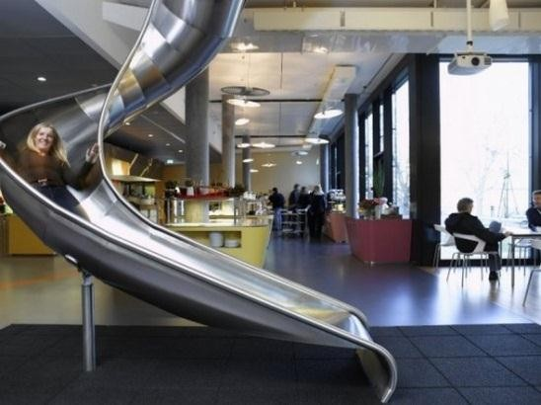
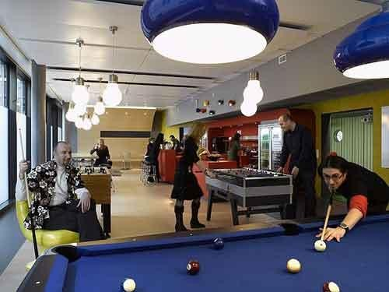
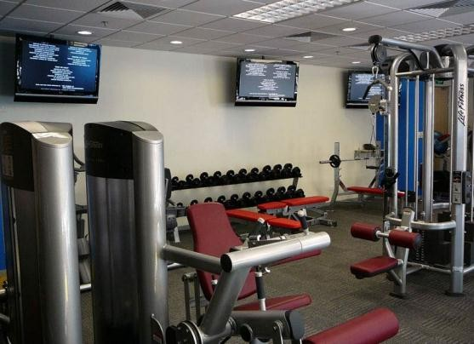
PM-CMM
Key Practice Areas of PM-CMM
  Work environment

Slide 9

Peoples involved in Software Process
Stakeholders
Team Leaders
Software Team

Slide 10
The Stakeholders
They can be categorized into one of the following
  Senior Managers
    they define business issues that often have significant influence on business
  Project (technical) managers
    they must plan, motivate, organize and control the practitioners who do
software work
  Practitioners
    They deliver the technical skills necessary to engineer a product or application
  Customers
    They specify the requirements for the software to be engineered
  End Users
    They interact with the software after it is released for production use

Slide 11
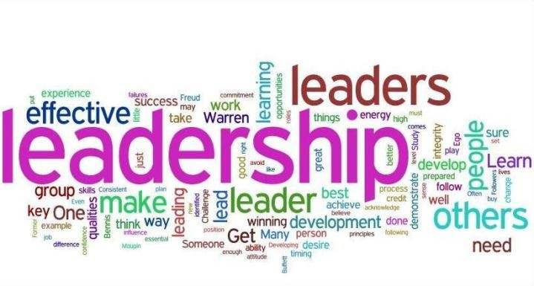
The Team Leaders
Competent Practitioners often make poor team leaders as they
lack the right mix of skills.
In his excellent book of technical leadership, Jerry Weinberg
suggests an MOI model of leadership
  Motivation
    Encourage technical people (by “push” or “pull” ) to produce
  Organization
    Apply, improve processes efficiently
  Ideas or Innovation
    Make people feel creative
    Be Creative

Slide 12

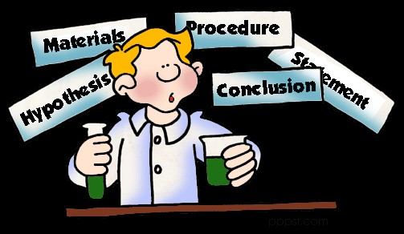


The Team Leaders
The Team Leaders
managers:
- Characteristics of an effective project
Problem Solving
  Diagnostic
  Skill to solve
  Ability to design solution
Managerial Identity
  Control the project

Slide 13


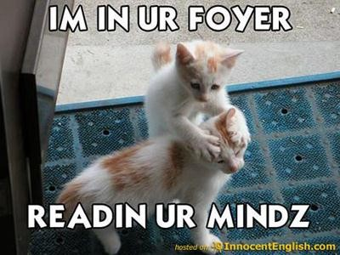

The Team Leaders
The Team Leaders
managers:
  Achievement
    Reward Initiative
- Characteristics of an effective project
Encourage Controlled risk taking
Influence and team building
  Influence the team
  Read people’s mind and respond according to their needs
  Be controlled in stress situations

Slide 14

The Software Teams
Organizations/Structure of teams:
  Democratic decentralized
  Controlled decentralized
  Controlled centralized

Slide 15
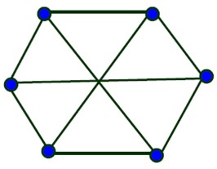
The Software Teams: Democratic decentralized
Democratic decentralized
  No permanent leader
  Communication is horizontal
  Suitable for small projects requiring less than 5 to 6 engineers, research- oriented projects

Slide 16
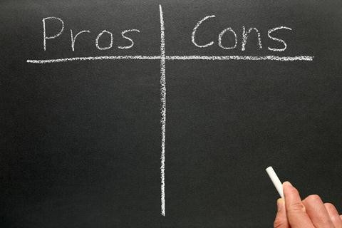
The Software Teams: Democratic decentralized
At different times, different
members within the team
provide technical leadership.
Team members may waste time
arguing about trivial points due to absence of any authority in the team.
High morale and job satisfaction due to autonomy, hence less employee turnover.

Slide 17
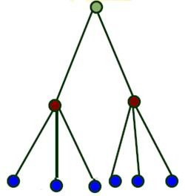
The Software Teams: Controlled Centralized
Controlled centralized
  Defined team leader
  Problem solving , communication and management by team leader
  Communication is vertical

Slide 18
The Software Teams: Controlled Centralized
The senior engineer/leader partitions tasks, verifies and integrates the products developed by members.
Too much responsibility & authority is assigned to leader, possibility of single point of failure

Slide 19
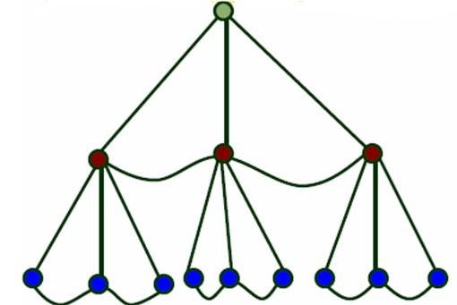
The Software Teams: Controlled Decentralized
Controlled decentralized
  Draws upon the ideas from both earlier structures
  Defined Leader
  Horizontal communication
  Problem solving is a group activity
  Suitable for large organizations

Slide 20
The Software Teams
Mantei describes seven factors that should be considered when
planning team structure:
  Difficulty of task
  Size of resultant code (no. of lines)
  Time that team will stay together
  Degree of modularization
  Required quality and reliability of the system being built
  Rigidity of delivery date (schedule)
  Degree of communication

Slide 21
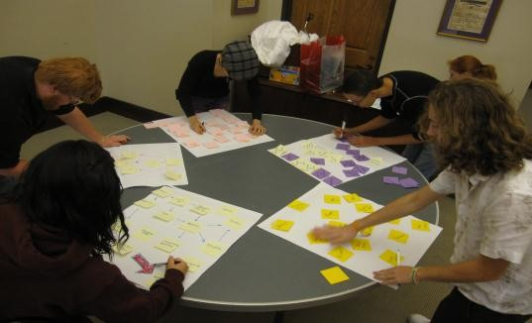
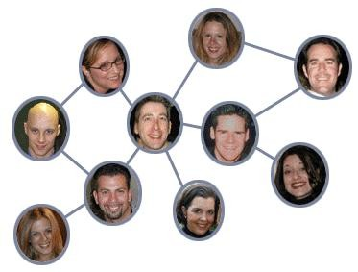
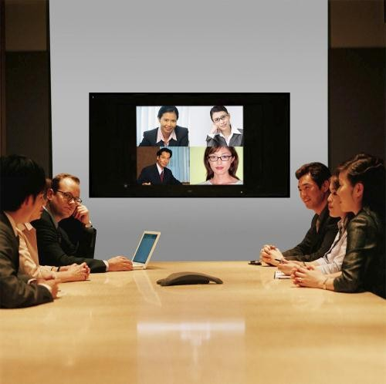
Communication & Coordination Issues
Formal approaches
  Writings (SE documentation, Customer requests, etc.)
  Status review meetings
  Design and code inspections
Informal approaches (more personal)
  Interpersonal networking [9]
  Sharing of ideas on ad hoc basis
  Seeking help from inside or outside the project team when problem arises
Electronic Communication
  E-mail, electronic bulletin boards [10]
  video conferencing

Slide 22

The Product [1]
Software Scope
Problem Decomposition

Slide 23
The Product
The product and the problem that is intended to solve must be examined at the very beginning of the software project.
The scope of product must be established and bounded.
  Bounded scope means:
    Establishing quantitative data like no. of simultaneous users, maximum allowable response time etc.
    Constraints and limitations
    Mitigating factors described
The problem that the product is addressing must be decomposed

Slide 24

Software Scope
Scope is defined by
  Context
    Functional location of the software product into a large system, product or business context
    Constraints involved
  Information Objectives
    What data objects are required as i/p or o/p
  Function and Performance
    What function does the software system perform on i/p to produce o/p
    What level of performance is required

Slide 25
Problem Decomposition
Also called partitioning OR problem elaboration
This activity is at the core of requirements analysis
Divide and conquer policy for complex problems
A complex problem is partitioned into smaller problems that
are more manageable.
Decomposition makes planning easier.
Decomposition in 2 major areas
  Functionality that must be delivered
  Process that will be used to deliver product

Slide 26
References
1.
Software Engineering by Roger Pressman
Team Structures Portion taken from Gary Pollice lectures on Software Project Management http://recruitment.naukrihub.com/recruitment-vs-selection.html
http://en.wikipedia.org/wiki/Performance_management http://en.wikipedia.org/wiki/Workers%27_compensation http://www.inovus.com/organiza.htm http://www.wisegeek.com/what-is-career-development.htm
http://pathikconsulting.com/team-and-culture-development-corporate-culture-consulting.html http://www.conx2u.com/index.php?option=com_content&view=article&id=53&Itemid=55
http://en.wikipedia.org/wiki/Bulletin_board_system
2.
3.
4.
5.
6.
7.
8.
9.
10.

Slide 27


